Slide 1
Course Induction
Introduction to Internet Of Things
[Theory & Practical]

Slide 2
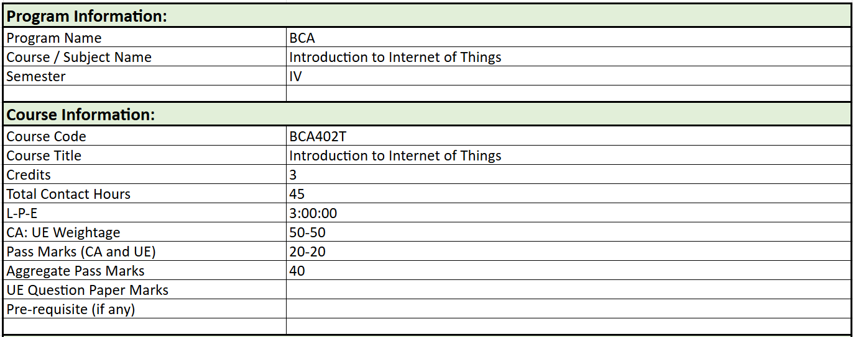

Slide 3
Course Outcomes (CO)
CO1 | Explain the vision, definition, and conceptual framework of IoT.
CO2 | Analyze the design principles for connected devices.
CO3 | Identify and classify various sensors, actuators, and IoT-supported hardware platforms.
CO4 | Compare and evaluate network communication protocols and methodologies used for wireless sensor networks and data aggregation in IoT.
CO5 | Demonstrate the ability to program Arduino boards using the Arduino IDE and integrate libraries to develop basic IoT systems.
CO6 | Analyze the solutions to challenges in IoT design, including security and development.

Slide 4
Syllabus:
Unit 1: Internet of Things (IoT)
Vision, Definition, Conceptual Framework, Architectural view, technology behind IoT, Sources of the loT, M2M Communication, loT Examples. Design Principles for Connected Devices: IoT/M2M systems layers and design standardization, communication technologies, data enrichment and consolidation, ease of designing and affordability.
Unit 2: Hardware for loT
Sensors, Digital sensors, actuators, radio frequency identification (RFID) technology, wireless sensor networks, participatory sensing technology. Embedded Platforms for loT: Embedded computing basics, Overview of IOT supported Hardware platforms such as Arduino, NetArduino, Raspberry pi, Beagle Bone, Intel Galileo boards and ARM cortex.

Slide 5
Unit 3: Network & Communication aspects in loT
Wireless Medium access issues, MAC protocol survey, Survey routing protocols, Sensor deployment & Node discovery, Data aggregation & dissemination.
Unit 4: Programming the Arduino
Arduino Platform Boards Anatomy, Arduino IDE, coding, using emulator, using libraries, additions in arduino, programming the arduino for loT.
Unit 5: Challenges in IoT Design challenges
Development Challenges, Security Challenges, Other challenges loT Applications: Smart Metering, E-health, City Automation, Automotive Applications, home automation, smart cards, communicating data with H/W units, mobiles, tablets, Designing of smart street lights in smart city.

Slide 6
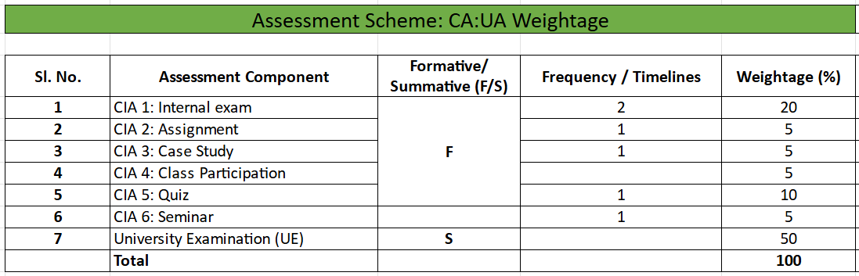

Slide 7
Coursera | Introduction to the IoT and Embedded Systems. By the University of california.
Textbook | IoT Architecture and Design Principles by Raj Kamal

Slide 8
Thank You

